Slide 1








a
Power BI Project – FMCG Domain
AtliQ Hardware
Business Intelligence 360
Presented by: Yogananda Gopi Krishna
Credits : Code basics Team

Slide 2
Overview
About Company – Business model
How Teams work in a company
Problem Statement
Data Source – Data Description
Key Variables
Data Modelling
Profit and Loss Statement
Business Terms
Overview of Dashboard
Summary

Slide 3








About Company – Business model
Atliq Hardware is a leading manufacturer and supplier of computer hardware and peripherals. As a consumer electronics company, it operates globally, catering to markets in various countries.
AtliQ Hardware
Customers
Consumers
Amazon Flipkart Croma…

Slide 4
AtliQ Hardware – Business Model
AtliQ Hardware
Customers
Consumers
Amazon Flipkart Croma…

Slide 5
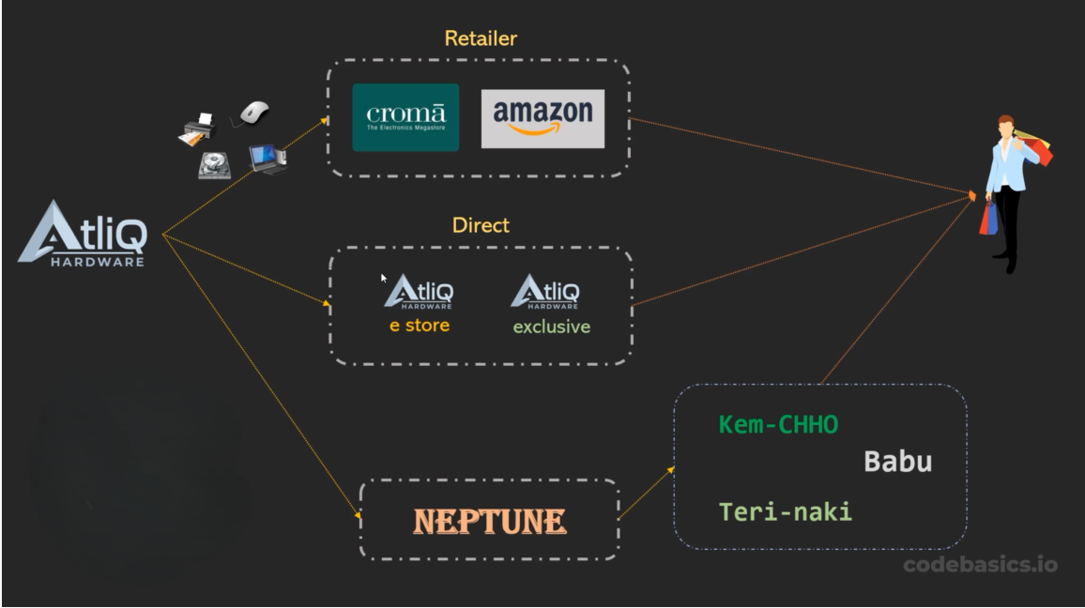
AtliQ Hardware – Business Model

Slide 6

Executives
Finance Team
Marketing Team
Sales Team
Supply Chain Team

Slide 7
Problem Statement
Atliq Hardware stands out as one of the fastest-growing companies in the consumer electronics sector. However, despite its global presence and rapid expansion, the company still relies heavily on Excel files for data analytics. While Excel is a widely used tool, it poses limitations in terms of data consumption and effectiveness in generating actionable insights. This reliance on Excel became particularly evident when the company encountered significant losses in Latin America due to ineffective analytics.
In response to these challenges, senior executives have recognized the need to invest in a comprehensive data analytics project.

Slide 8
Data Source – Data Description
Gdb056 Database :
Freight_cost
Gross_price
Manfracturing_cost
Post_invoice_deductions
Pre_invoice_deductions
Gdb041 Database :
Dim_Customer
Dim_Market
Dim_Product
Fact_sales_monthly
Fact_forecast_monthly
Other tables :
Market_share
NsGmTarget

Slide 9
AtliQ Hardware Company
APAC
EU
NA
LATAM
ROC
INDIA
ANZ
SE
NE
NA
LATAM
Australia
NewZeland
India
Bangladesh
China
Indonesia
Japan
Pakistan
Philippines
SouthKorea
France
Italy
Spain
Portugal
Austria
Germany
Netherlands
Norway
Poland
Sweden
UK
Canada
USA
Brazil
Chile
Colombia
Mexico

Slide 10
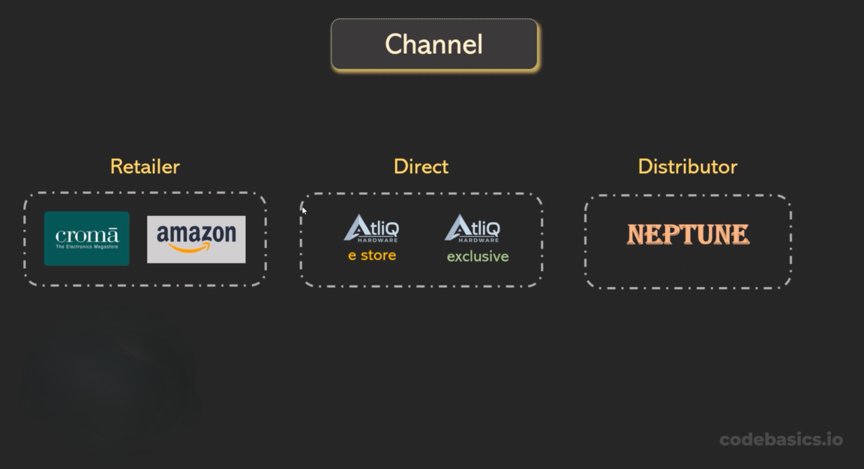
Key Variables

Slide 11
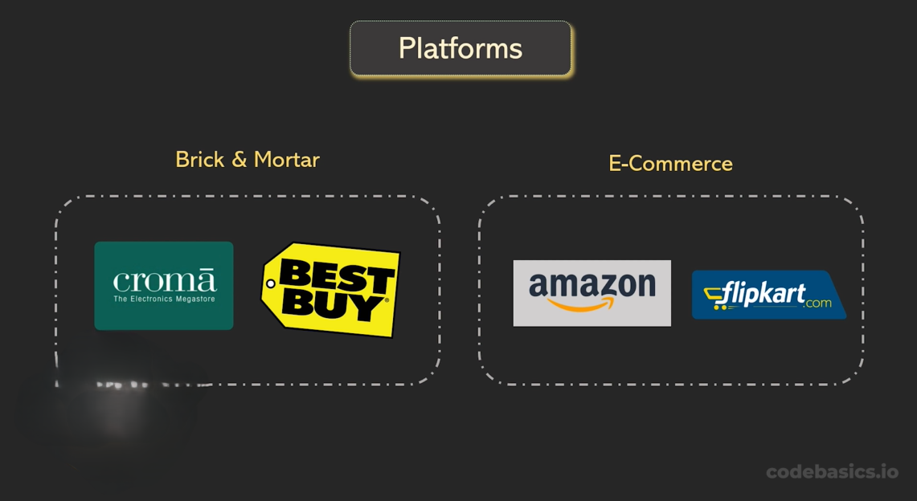
Key Variables

Slide 12
Key Variables
Customer table :
Platform brick and motor
E-commerce Channel Retailer direct Distributor product table segment division

Slide 13
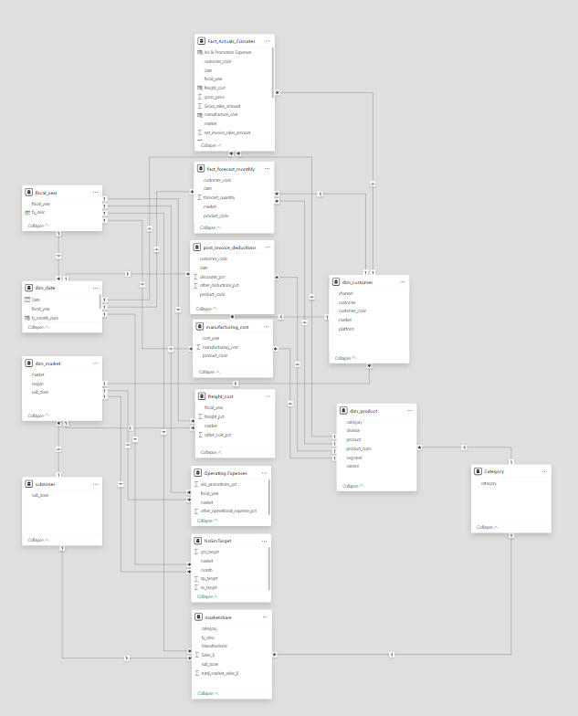

Data Modelling
Snow Flake Schema

Slide 14




Profit and Loss Statement
Gross Price ------> Total Revenue Generated - Pre Invoice deductions (Promotional + Discounts) Net Invoice Sales - Post Invoice Deductions (Allowances + returns ) Net Sales -------> Actual Revenue Generated - Total COGS (Manufacturing Cost + Freight cost + Other Costs )
Gross Margin -------> Gross Profit - Operating Expenses (AD’s + Promotions )
Net Profit ------> Actual Profit

Slide 15
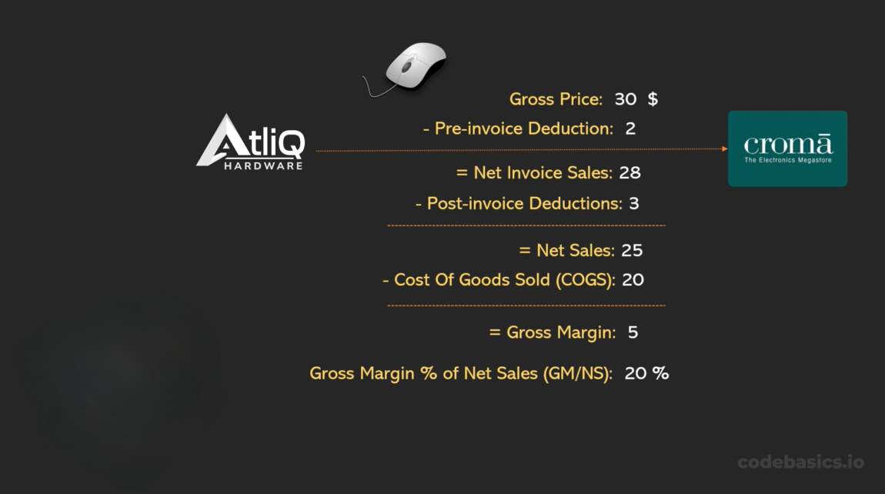
Profit and Loss Statement

Slide 16

Net sales $: Actual revenue generated after deductions, representing the total income received by a company from its sales activities.
Gross Margin $: Profit remaining after subtracting the cost of goods sold from net sales, indicating the amount available to cover operating expenses and generate profit.
Gross Margin %: The percentage of net sales that exceeds the cost of goods sold, revealing the efficiency of a company in managing production costs.
Net Profit $: Total earnings left after deducting all expenses, taxes, and interest from gross revenue, indicating the final profitability of a company.
Net profit %: The percentage of total revenue that translates into profit, reflecting a company's ability to generate earnings from its operations.
Net Error: Deviation between predicted and actual values, highlighting the inconsistency in forecasting outcomes.
ABS Error: Deviation from expected results, measured as the absolute difference between predicted and actual values, indicating the magnitude of forecasting discrepancies regardless of their direction
Forecast Accuracy: Precision of predictions compared to observed outcomes, reflecting the closeness between forecasted values and actual results
Fiscal Year : A fiscal year is a full year that a company uses to manage its money and keep track of its finances.
AtliQ Hardware Fiscal Year : SEPTEMBER - AUGUST
Business Terminology

Slide 17
Business Terminology
Fiscal Year :
A fiscal year is a full year that a company uses to manage its money and keep track of its finances.
AtliQ Hardware Fiscal Year : SEPTEMBER - AUGUST

Slide 18
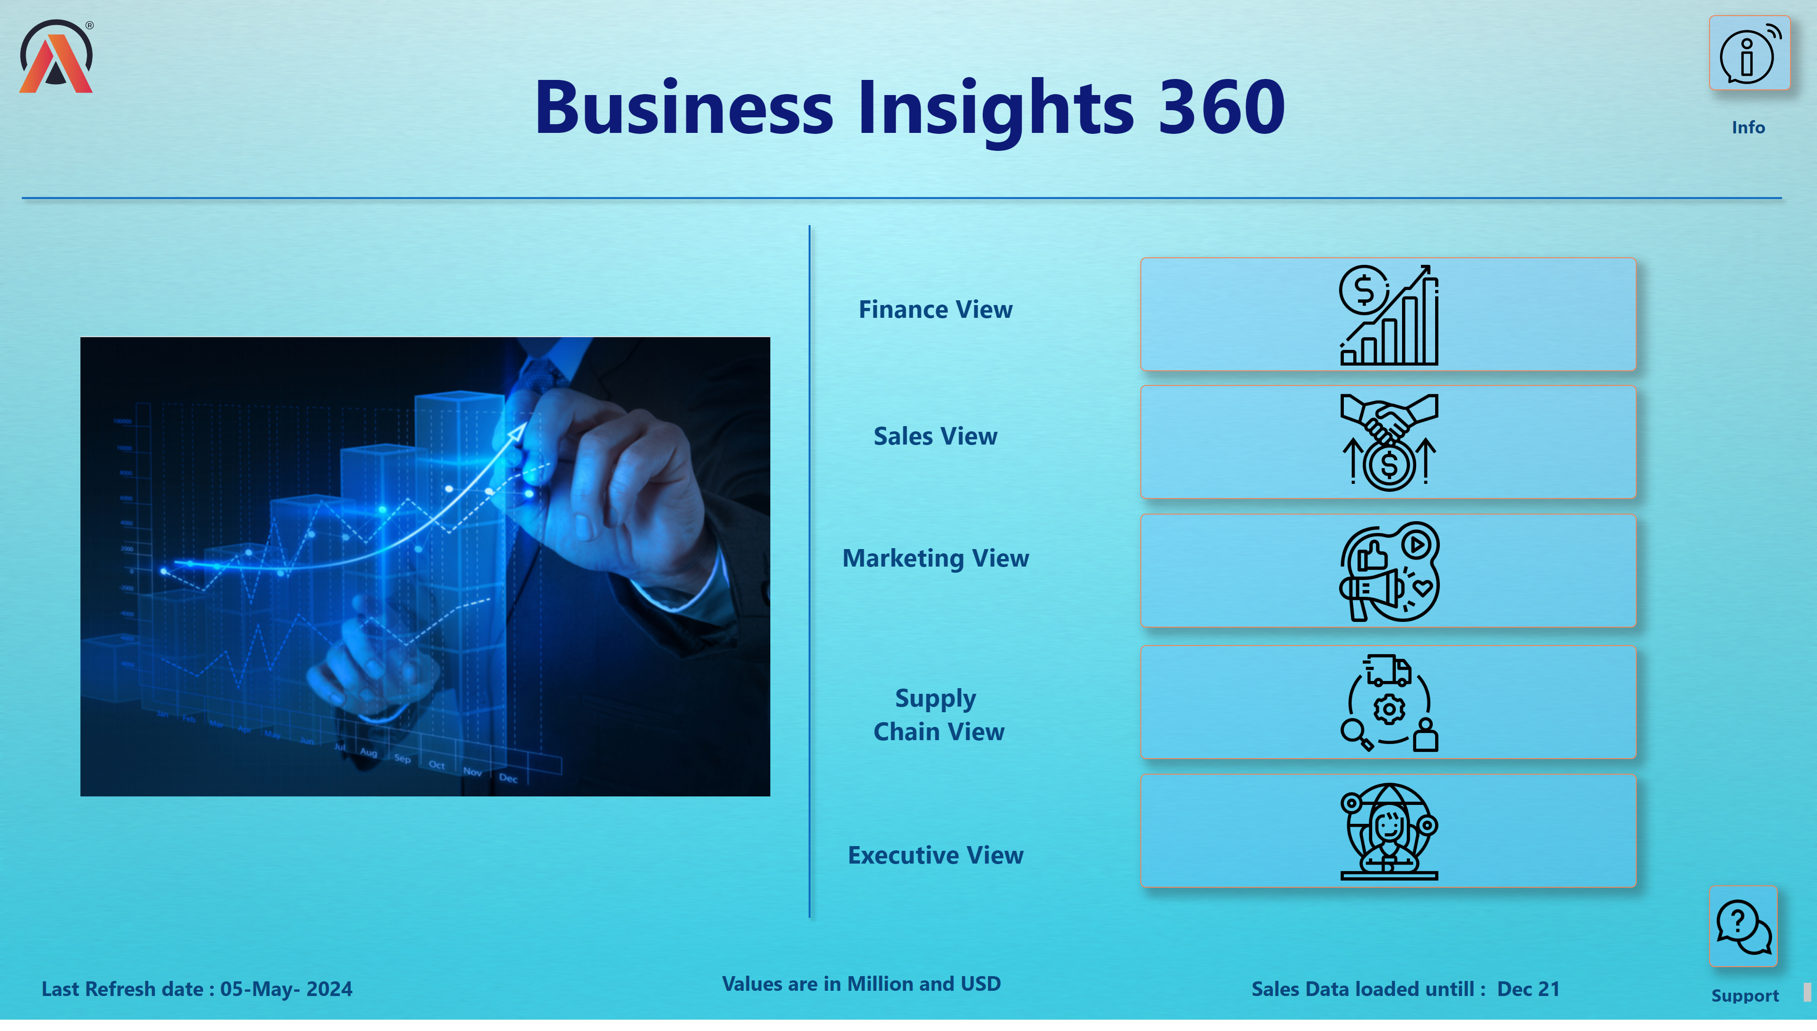
Home New
Notes:
image
No alt text provided
image
No alt text provided
image
No alt text provided
image
No alt text provided
image
No alt text provided
image
No alt text provided
textbox
No alt text provided
textbox
No alt text provided
textbox
No alt text provided
textbox
No alt text provided
textbox
No alt text provided
textbox
No alt text provided
textbox
No alt text provided
image
No alt text provided
image
No alt text provided
textbox
No alt text provided
card
No alt text provided
card
No alt text provided
shape
No alt text provided
image
No alt text provided
shape
No alt text provided
textbox
No alt text provided
textbox
No alt text provided
actionButton
No alt text provided

